Slide 1

Mental Health Ambassadors

Slide 2

Who are we?
Charlie
Louis
Annabel
Sukey
Jacob
Vesper
Scarlett
Willow
Lauren
Etana
Luca

Slide 3
Our role in school
Listening to you – if you feel down, sad or upset
Planning mental health activities – this assembly for World Mental Health Day, displays
Sharing ways to boost positive mental health and well-being
Being out on the playground
Meeting with Emma
Learning new skills

Slide 4
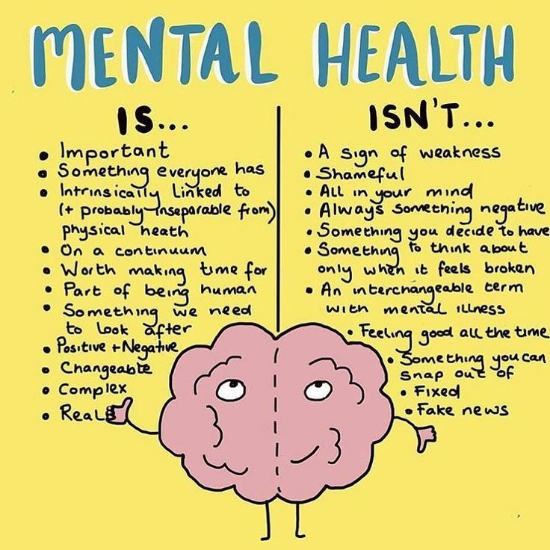
10th October – World Mental Health Day
What is mental health?

Slide 5

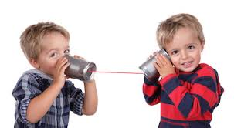


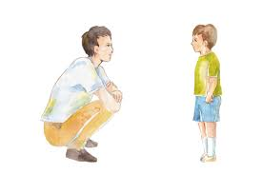

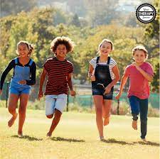

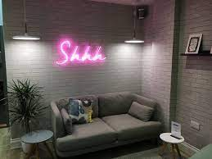
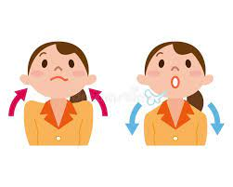
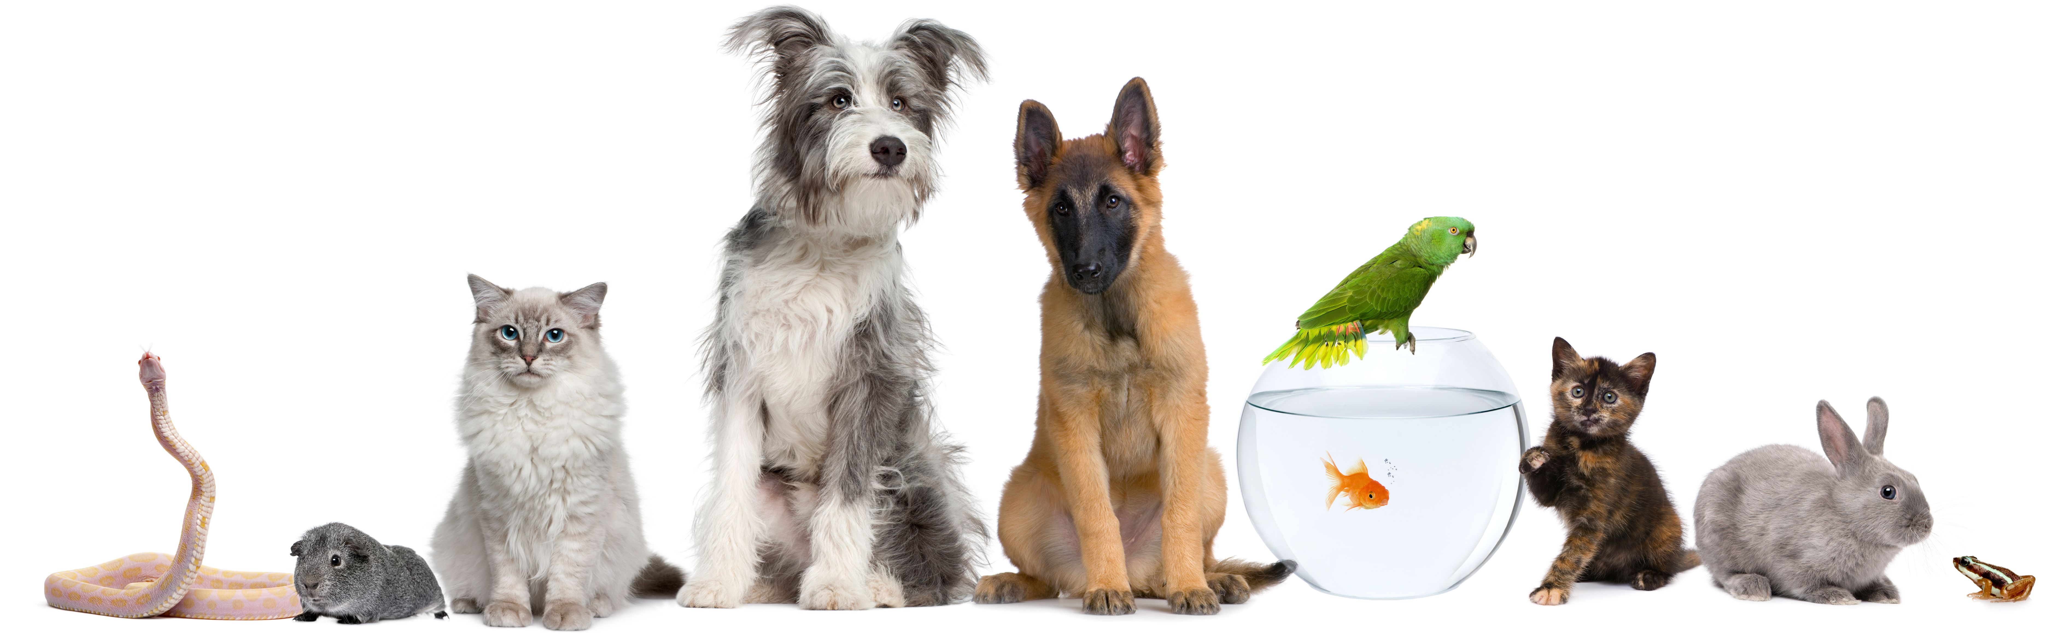
Here are some ways to boost your mental health and help you feel good

Slide 6


