Slide 1
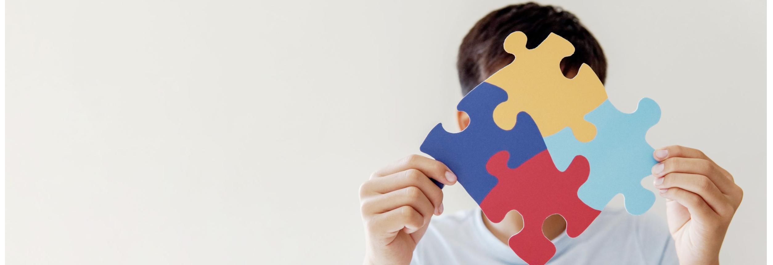
Assembly – How to view and explain Autism
Wednesday 25th February 2026

Slide 2
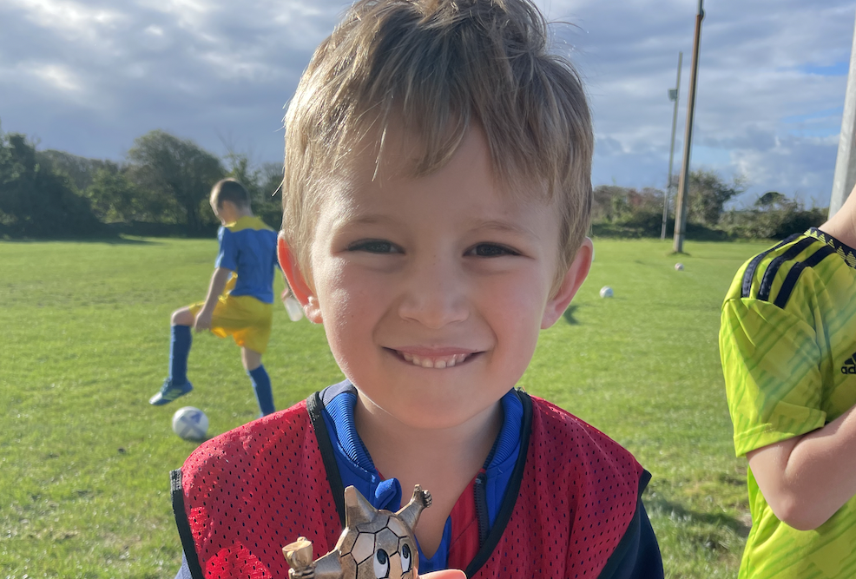
My name is Eli
I am 8 years old and I am in Year 4
I am Autistic and I will be your guide during this assembly
I will be guiding you on what is Autism, what it means and how it works
If you have any questions, please feel free to ask

Slide 3
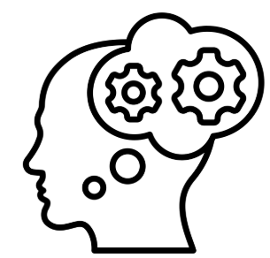
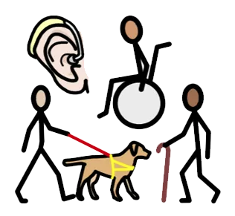

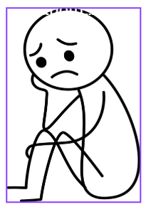
Children’s Rights
My presentation links to the United Nations Convention on the Rights of the Child (UNCRC)
Article 6: The right to live and grow as a person.
Article 14: The right to have my own thoughts.
Article 19: I have the right to be protected from being hurt or badly treated.
Article 23: If I am disabled, I have the right to special care and education.

Slide 4

Understanding Autism Together
Celebrating Differences
  Every person is unique and special. We all have our own strengths and ways of seeing the world
Encouraging Kindness
  Kindness helps everyone feel safe and happy. Being caring makes all friends feel welcome and included
Supporting Each Other
  Friends support each other in fun and creative ways, making everyone feel part of the group
Notes:
Image source: Microsoft 365 content library
Welcome to our friendly exploration of autism, designed especially for kids. This deck helps everyone learn how unique and wonderful autistic people are. Through colourful stories and simple facts, we celebrate differences, encourage kindness, and show how friends can support each other in fun ways.

Slide 5
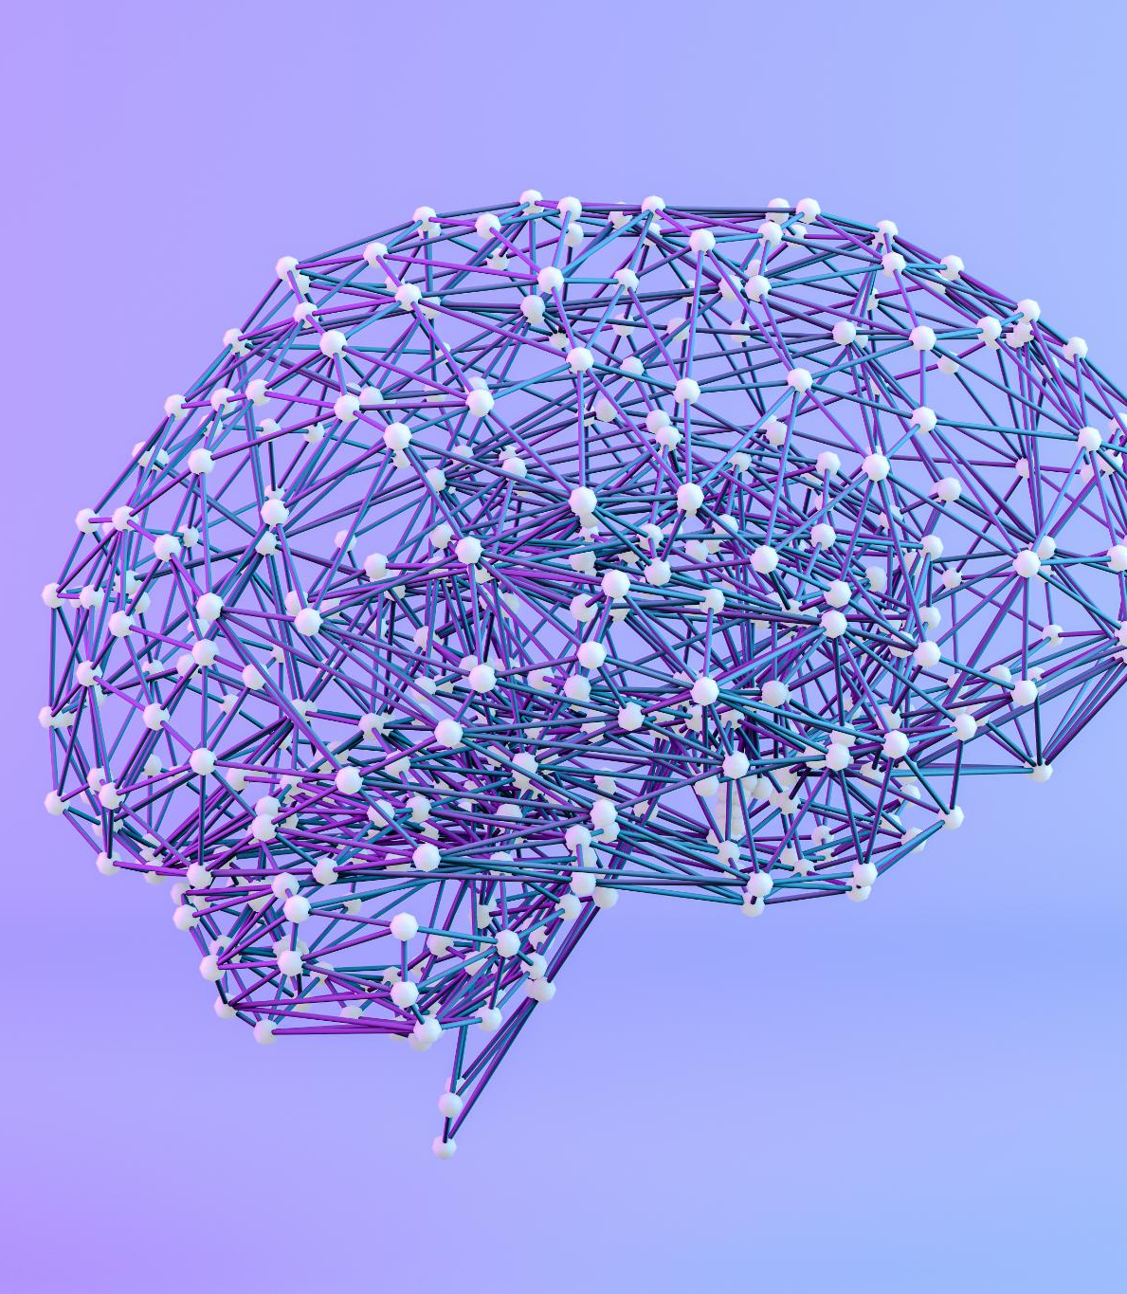
Facts about Autism
Autism means a person’s brain works differently
It is something you are born with
Autistic people may think, learn, move, or communicate differently
Every autistic person is different — no two are the same
Autism is not an illness, and it does not need to be “fixed”
Autistic people are part of the world just like everyone else
Boys are 4 times more likely to be diagnosed with autism than girls
Notes:
Image source: Microsoft 365 content library
Autism is a neurological condition affecting communication, behaviour, and social interaction. People with autism may experience sensory sensitivities and unique strengths. Early intervention, supportive environments, and increased awareness help individuals with autism to thrive and participate fully in society.

Slide 6
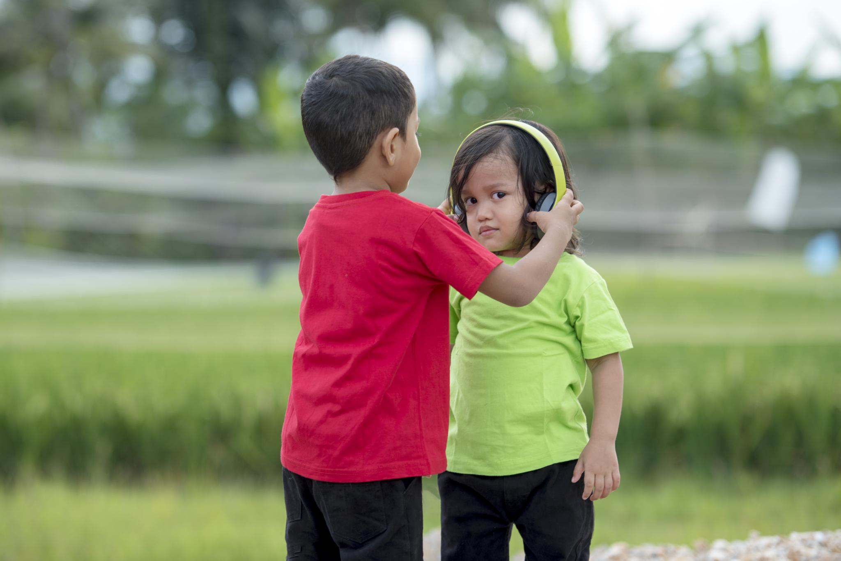
Why It Can Be Tricky
Social Interaction
Some autistic people talk a lot, and some talk very little. Autistic people like to think about the wonderful things in the World and might not appear to be very social
Autism can be hard to understand because you can’t always see it
Sensitivity
Autism can lead to under-sensitivity or over-sensitivity to sound (loud noises), bright lights, certain tastes and textures
Repetitive Behaviours
Children or Adults with autism may display some repetitive behaviours which can be comforting, for example, rocking on a chair or flapping their arms
Notes:
Image source: Microsoft 365 content library
In very noisy environments, children may wear ear defenders to safeguard their hearing. These devices help reduce exposure to harmful noise levels, decreasing the risk of hearing loss. Ear defenders also improve comfort and concentration, allowing children to participate safely in events like concerts, sports, or construction sites.

Slide 7
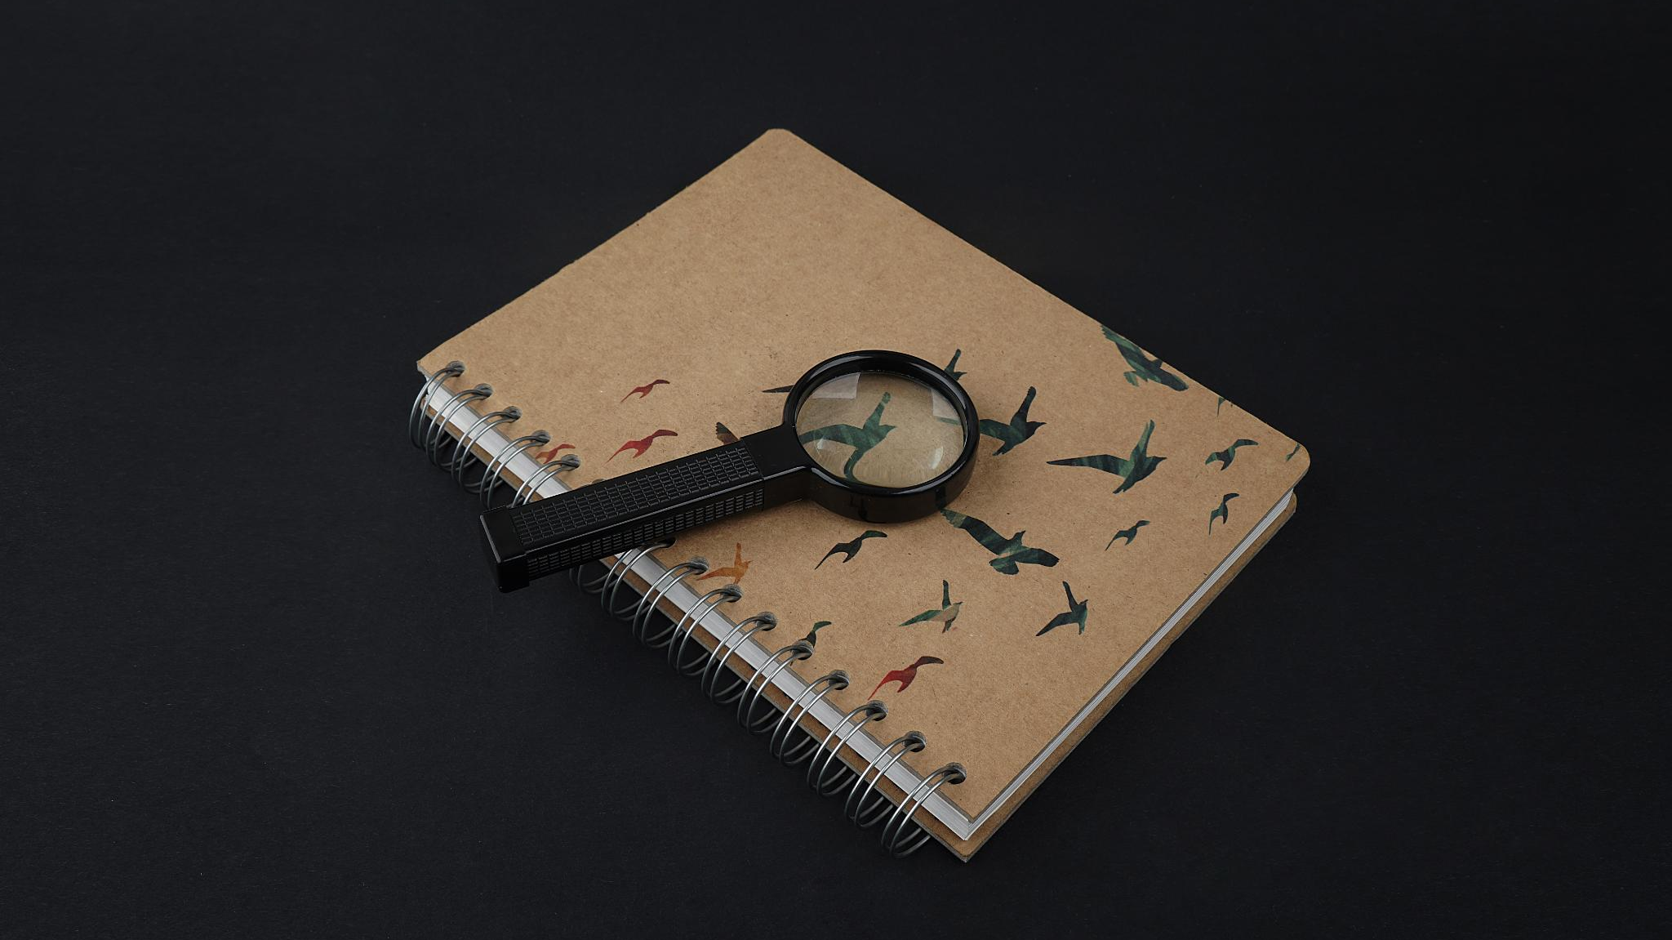
Types of Autism
Autism Spectrum Disorder (ASD)
It affects communication, behaviour, and social interaction differently
Asperger’s Syndrome
Asperger’s involves social difficulty, focused interests, and atypical communication patterns. That’s me!
PDA (Pathological Demand Avoidance)
PDA involves extreme avoidance of demands due to anxiety and control
Learning or Sensory Differences
People with autism have varying learning capabilities and can experience and interpret the world in unique ways
Notes:
Image source: Microsoft 365 content library
Begin with a photograph of an animal encyclopedia to spark curiosity. Collect information on various species by exploring the book, noting habitats, behaviours, and unique traits. Share findings in a cycle: observe, research, document, and present, encouraging continuous learning and appreciation for animal diversity.

Slide 8
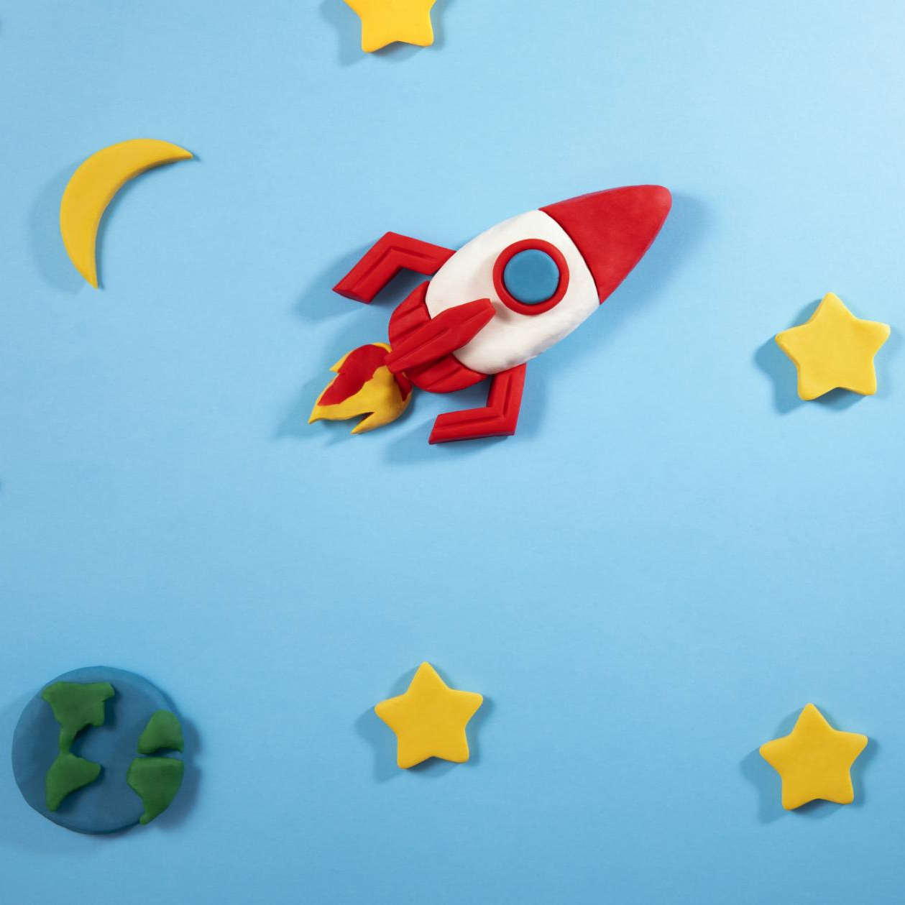
Awesome Autistic Abilities
Strong focus and amazing memory
Deep knowledge about favourite topics
Honest thinking and strong sense of fairness
Creativity, patterns, and problem-solving skills
Seeing the world in unique and wonderful ways
Notes:
Image source: Microsoft 365 content library
A children's background themed around exploration features colourful rockets, telescopes, and science symbols to spark curiosity. Stars and planets add a touch of adventure, encouraging young minds to dream about space. This vibrant setting inspires learning and imagination through exciting visual elements.

Slide 9
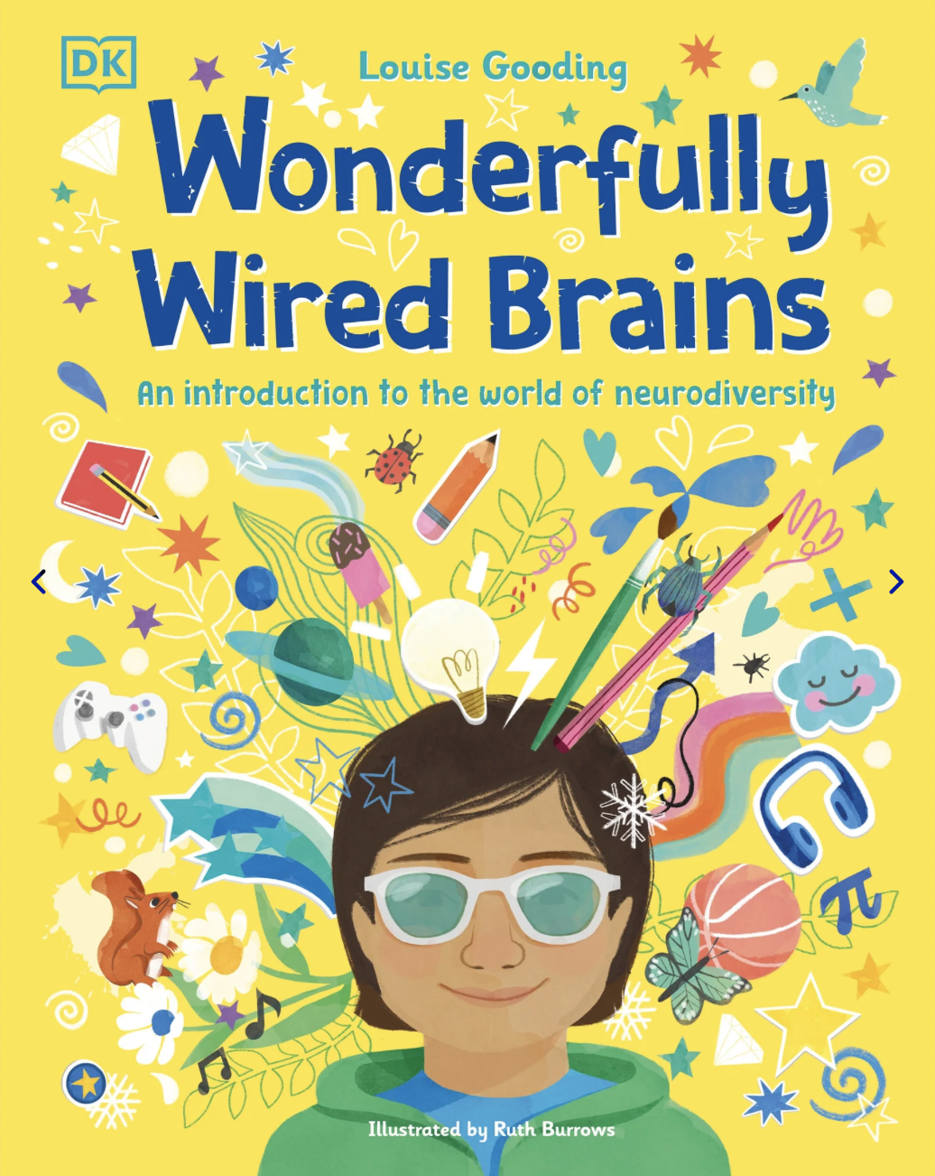
Book Recommendation
Wonderfully Wired Brains
Written by Louise Gooding
“Wonderfully Wired Brains" explains how different brains work, thrive, it challenge stereotypes and provides a wonderful insight into the world of Neurodiversity
Notes:
Image source: Microsoft 365 content library
‘The Wonderfully Wired Brains’ is a recommended read for understanding the diversity of human cognition. The book explores neurodiversity, celebrating the strengths in different ways brains function. It offers insightful stories and practical advice, making it ideal for educators, parents, and anyone interested in brain science and individual differences.

Slide 10
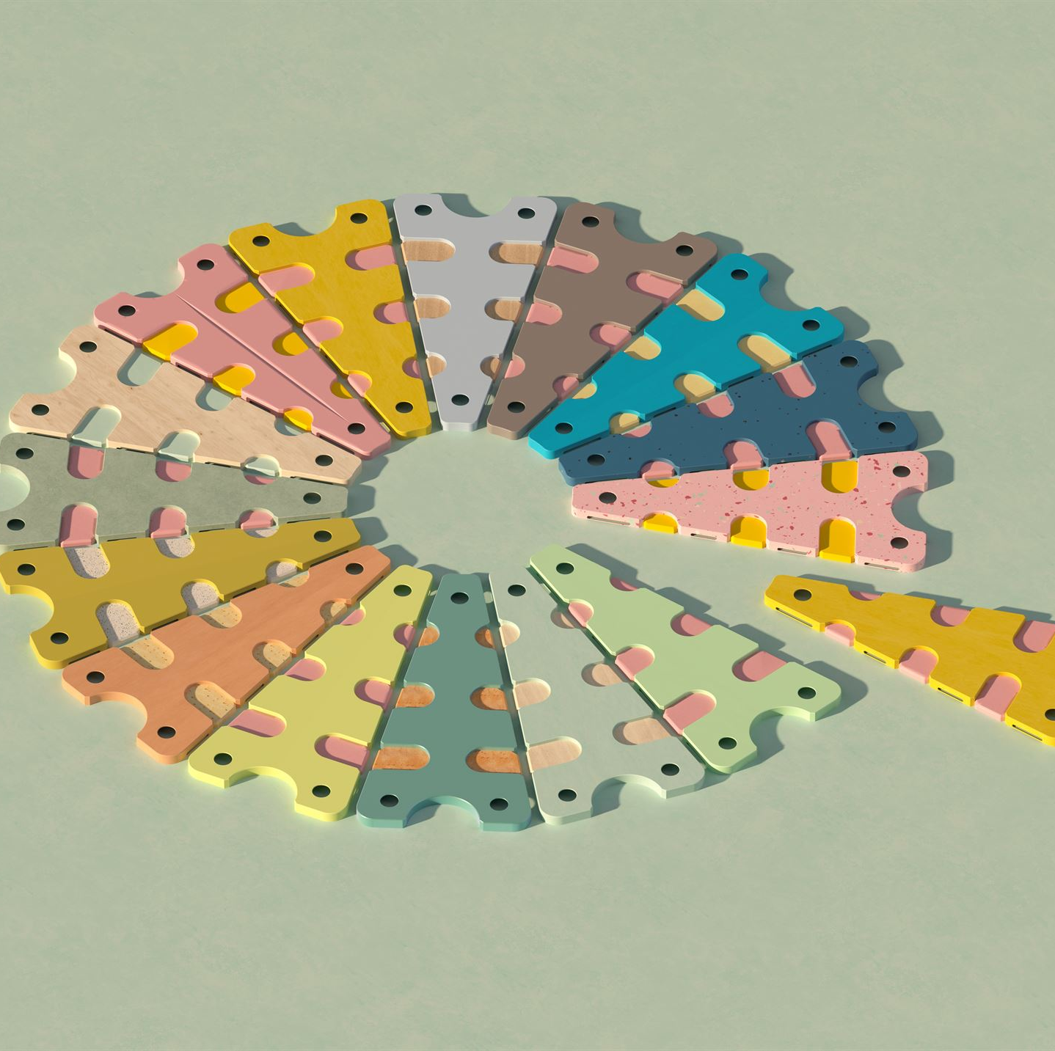
Thank You
Any questions?
Notes:
Image source: Microsoft 365 content library
We appreciate your commitment to autism awareness and inclusion. Your support helps create a more accepting and empathetic society for neurodiverse individuals. Together, we can continue to celebrate differences, encourage understanding and foster meaningful opportunities for everyone touched by autism.

